Slide 1
City of providence 8-Law LEGISLATIVE proposal (2025 – H 5688)
Robert Azar, Deputy Director of Planning and Development
Emily Freedman, Director of Housing & Human Services
Michael Napolitano, Director of Intergovernmental Affairs
Seth Zeren, VP for Development, Armory Management
March 13, 2025
Notes:
TITLE SLIDE – DARK VERSION
Please refrain from moving any of the graphics. Please only add white / light color logos on this page if necessary.
Do not use both the dark and light title slides in one powerpoint.
All slide templates can be found under the New Slide dropdown menu.
Please use the colors and font provided as much as possible. If you want to implement other colors / designs, please assign to Emily Snow for review.
If you need font files or have any further questions, please email Emily Snow, graphic designer, at esnow@providenceri.gov

Slide 2
Importance of “8-Law”
8-Law is a powerful tool in Rhode Island's toolbox to incentivize development of low- and moderate-income housing and ensures that low-income rental housing units can operate sustainably.
However, clarity on how the tool should be targeted, deployed, and applied is necessary for predictability and project viability.

Slide 3
Background
Bill sponsors have introduced House Bill 5688 to make targeted amendments to 44-5 (Levy and Assessment of Local Taxes) to clarify applicability and qualification for what we know as “8-Law” (preferential tax treatment for affordable housing).
Existing 8-Law enables qualified developments to receive a deeply-discounted, preferential tax treatment (8 percent of gross potential annual rental income in lieu of the commercial tax rate) provided the development restricts either tenant incomes or rents charged.
Amendment to state law is necessary to ensure uniformity of application and that the law complies with the original intent (to incentivize and ensure affordability) for deed-restricted rental housing.
Notes:
TITLE + CONTENT SLIDE
I would not recommend changing any of these content slides into a dark version.

Slide 4
Proposal
New Construction & Substantial Rehabilitation
Clarify how to apportion the tax treatment appropriately to residential square footage meeting minimum affordability requirements.
Codifies that both new construction & substantial rehab projects qualify.
Removes application to commercial square footage.
Goal: ensure clarity for municipal assessment across all 39 cities/towns, remove unintended incentives, and ensure predictability for developers.

Slide 5
Proposal
Affordability
Establish minimum affordability thresholds.
At least 40% of rental dwelling units affordable to households at or below 80% AMI; or
At least 30% of the rental dwelling units affordable to households at or below 60% AMI.
Ensure that both tenant incomes and rents are restricted.
Align with state definition at RIGL 45-53-3 and elsewhere in statute, and with other subsidy thresholds (ex. LIHTC).
Goal: clarify affordability definition and thresholds that must be met to receive the benefit.

Slide 6
Proposal
Existing Properties
Properties previously granted 8-Law prior to 12/31/2024 shall retain the tax treatment.
Goal: ensure projects subsidized and underwritten with 8-Law taxation remain viable and do not experience any unforeseen operating shocks.

Slide 7
Proposal
Adaptive Reuse: Office-to-Housing Conversions
Allow projects that fully convert commercial properties into residential units to receive 8-Law treatment for limited number of years, with escalating tax rate over time.
Goal: build upon General Assembly’s good work in 2022 & 2023 to facilitate adaptive reuse to create pathways to new housing at all price levels. Seeks to mitigate some lingering barriers to conversion.

Slide 8
Proposal
Office-to-Housing Conversions
State Dept. of Housing proposed 15,000 new units by 2030 will require significant private investment and adaptive reuse.
In Providence, we have embraced zoning reforms, but of the thousands of units approved, only hundreds get built due to rising construction costs and lack of predictability.
1.9% rental housing vacancy rate (6-7% "healthy")
Exponentially higher office space vacancy rate

Slide 9
Impact on Housing Investment
Seth Zeren, Partner, VP for Development
Armory Management Company
Rhode Island needs billions of dollars of investment in new homes to meet the goals of our state-wide housing plan.
Private investment follows predictability.
As a private developer, we have faced 25%, 50%, 100% annual increases in property taxes without corresponding revenue increases.
As our largest investor said: "It seems hard to justify investment in Providence without some special deal or protection on taxes."

Slide 10
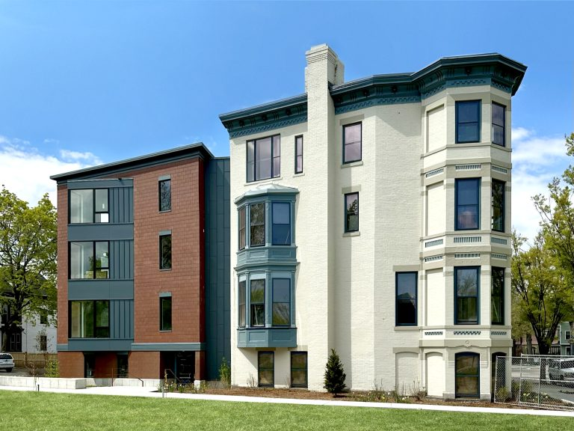
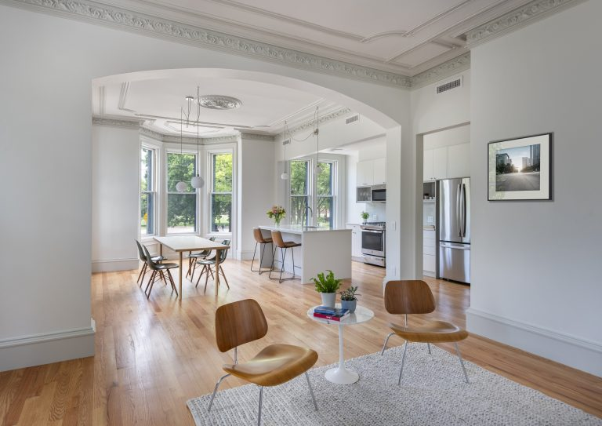
Case Study: 31 Parade Street
Adaptive reuse of historic property (original home of Miriam Hospital)
Project required a Tax Stabilization Agreement
Assessments have more than doubled in the last two years. Without a TSA we'd be talking about giving the building back to the bank or in court.

Slide 11
What's a Building Worth?
Income (rent) – Expenses (taxes, insurance, utilities, maintenance) =
Net Operating Income (NOI)
What would you pay today for an income of $1,000 per year in the future?
The Income Value of a building today is based on the future flow of NOI, divided by a market rate of return called the CAP rate. (Typically, 5% on the low end to 10% on the high end)
An NOI of $1,000 would be worth between $20,000 and $10,000 to buy today.
When Expenses go up the value of the Building goes down. If the Value goes below the
Income value < the cost of construction, land, design, permits, financing costs, investor return, and developer profit the project fails or doesn't get built.
A $1,000 increase in property taxes equals a roughly $15,000 decrease in property value.
(At a 7% CAP rate)

Slide 12
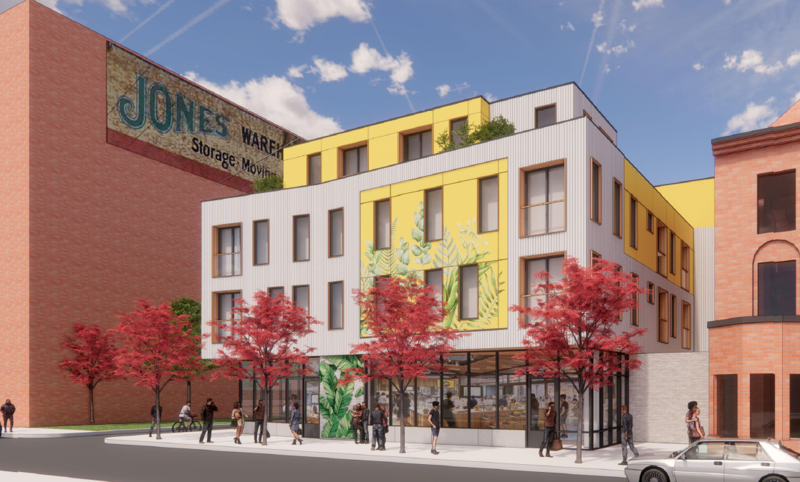
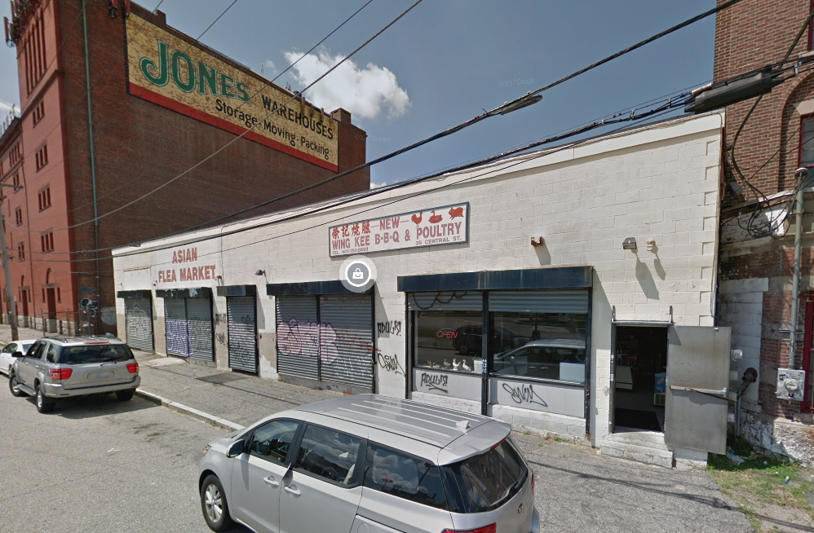
Case Study: Single-Story Rehab
Planned redevelopment of 45 Central
19 apartments + 2 stores (20k sf)
Estimated cost: $7.8M
Income: $662k - $113k tax - $80k other op-ex
NOI: $469k = $6.7M
Adaptive Reuse Instead
10 apartments (9k sf)
Estimated cost: $3.15M
Income: $334k - $26k tax - $36k other op-ex
NOI: $262k = $3.75M

Slide 13
Conclusion
Amending the existing legislation will allow for predictability in determining the viability of development for affordable housing and adaptive reuse projects.
The legislation will close loopholes that have allowed 8-Law to be used in a way that is inconsistent with the intention of the original law.
The Amendment will create a pathway for new development to occur through adaptive reuse and the ability for new construction to be considered for 8-Law treatment.

Slide 14
THANK YOU
City of Providence
Notes:
END SLIDE – DARK VERSION

